Slide 1

Chapter 36 JTable and JTree

Slide 2
Objectives
To display tables using JTable (§36.2).
To process rows and columns using TableModel, DefaultTableModel, TableColumnModel, DefaultTableColumnModel, and ListSelectionModel (§§36.3-36.5).
To enable auto sort and filtering on table model (§36.4).
To add rows and columns, delete rows and columns (§36.5).
To render and edit table cells using the default renderers and editors (§36.6).
To render and edit table cells using the custom renderers and editors (§36.7).
To handle table model events (§36.8).
To display data in a tree hierarchy using JTree (§36.9).
To model the structure of a tree using using TreeModel and DefaultTreeModel (§36.10).
To add, remove, and process tree nodes using TreeNode, DefaultMutableTreeNode, and TreePath (§36.11).
To select tree nodes and paths using TreeSelectionModel and DefaultTreeSelectionModel (§36.12).
To render and edit tree nodes using the default and custom renderers and editors (§36.14).

Slide 3
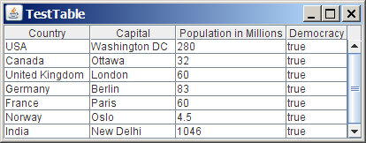
JTable
JTable is a Swing component that displays data in rows and columns in a two-dimensional grid.

Slide 4
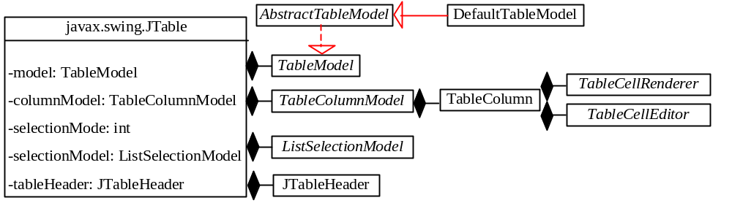
JTable and Its Supporting Models
NOTE: All the supporting interfaces and classes for JTable are grouped in the javax.swing.table package.

Slide 5
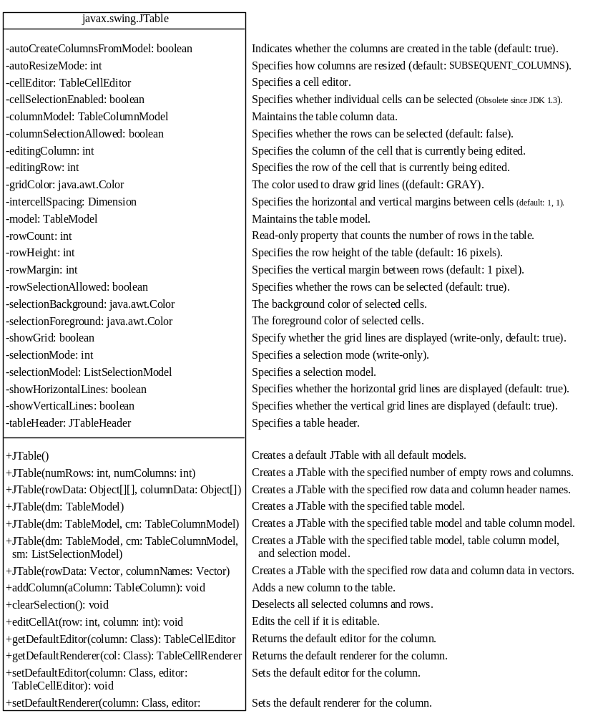
The JTable Class

Slide 6
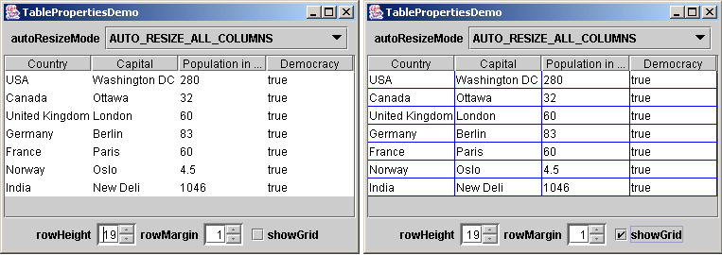
Example: Table Properties Demo
Problem: This example demonstrates the use of several JTable properties. The example creates a table and allows the user to choose an Auto Resize Mode, specify the row height and margin, and indicate whether the grid is shown.
TablePropertiesDemo
Run

Slide 7
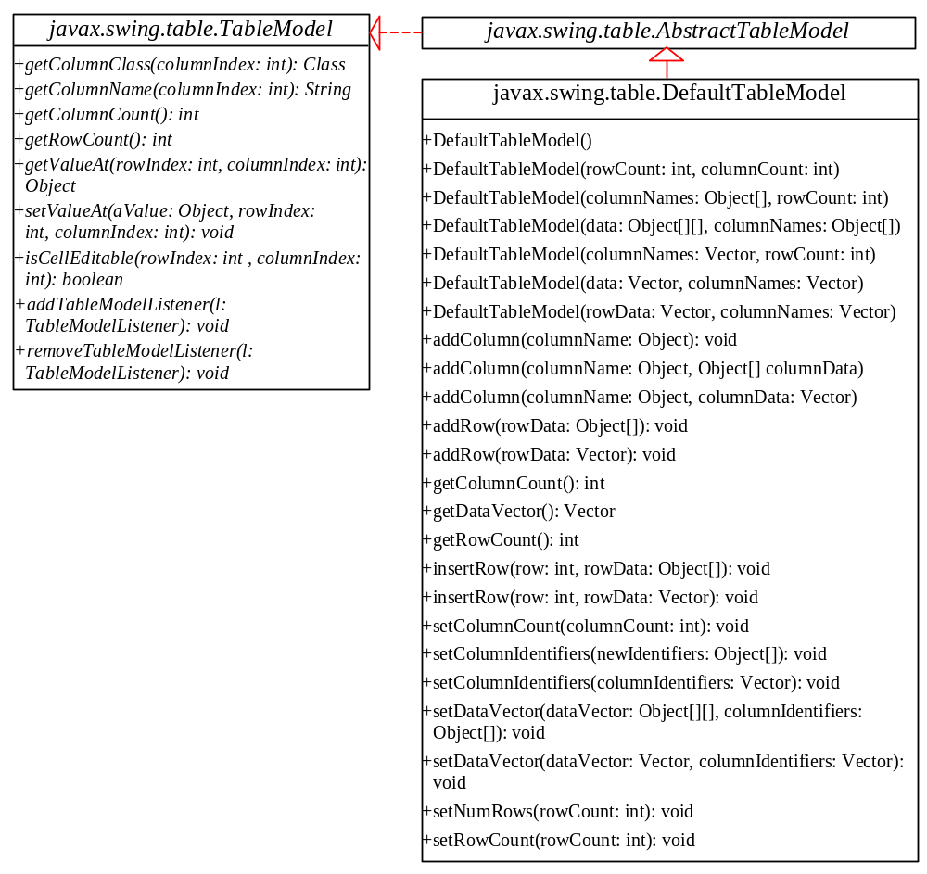
Table Models
JTable delegates data storing and processing to its table data model. A table data model must implement the TableModel interface, which defines the methods for registering table model listeners, manipulating cells, and obtaining row count, column count, column class, and column name.
The AbstractTableModel class provides partial implementations for most of the methods in TableModel. It takes care of the management of listeners and provides some conveniences for generating TableModelEvents and dispatching them to the listeners.
The DefaultTableModel provides concrete storage for data using a vector.

Slide 8
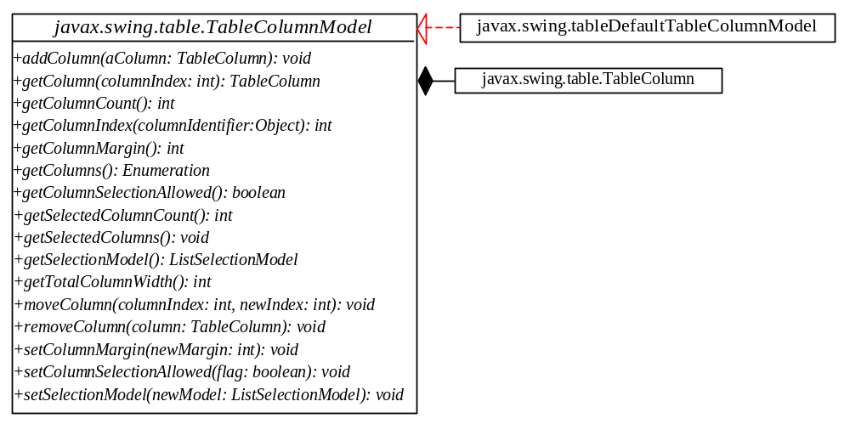
Table Column Model
DefaultTableColumnModel is a concrete class that implements TableColumnModel and stores its columns in a vector and contains an instance.
Table column models manage columns in a table. They can be used to select, add, move, and remove table columns. A table column model must implement the TableColumnModel interface, which defines the methods for registering table column model listeners, and for accessing and manipulating columns.

Slide 9
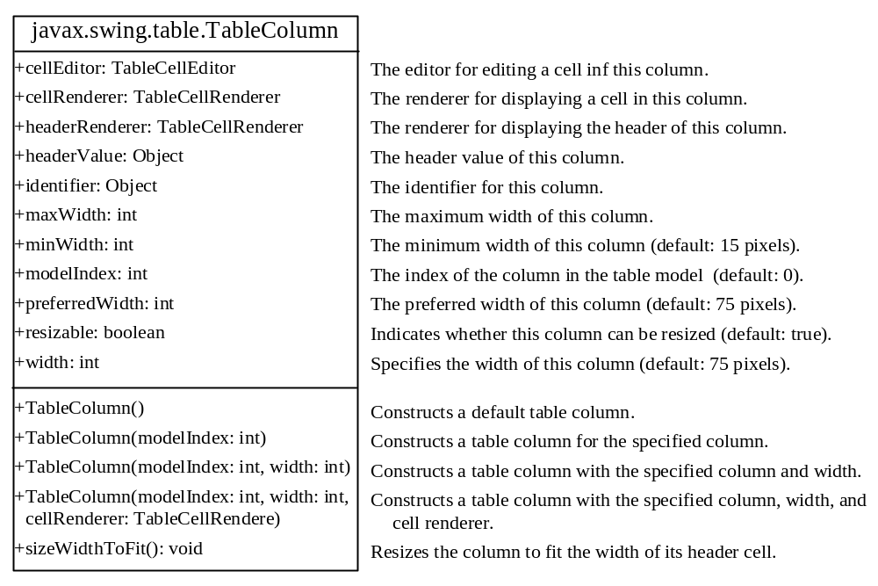
The TableColumn Class
The column model deals with all the columns in a table. The TableColumn class is used to model an individual column in the table. An instance of TableColumn for a specified column can be obtained using the getColumn(index) method in TableColumnModel or the getColumn(columnIdentifier) method in JTable.

Slide 10
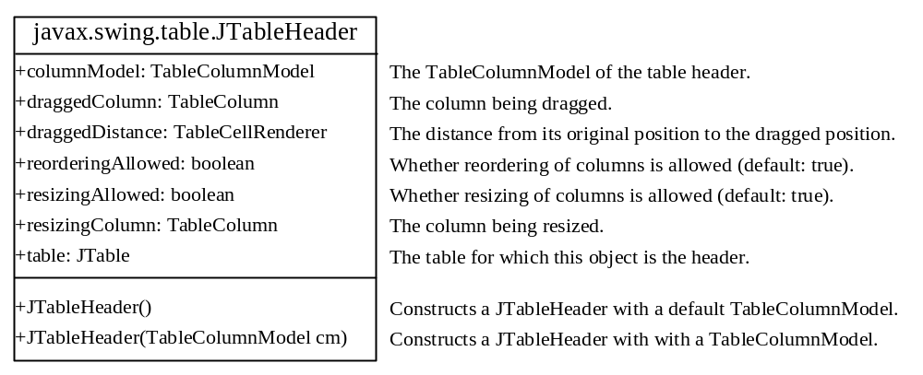
The JTableHeader Class
JTableHeader is a GUI component that manages the header of the JTable (see Figure 36.29). When you create a JTable, an instance of JTableHeader is automatically created and stored in the tableHeader property.

Slide 11
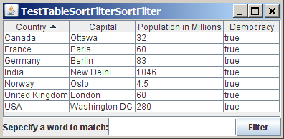
Auto Sort and Filtering
Auto sort and filtering are two useful new features in JDK 1.6. To enable auto sort on any column in a JTable, create an instance of TableRowSet with a table model and set JTable’s rowSorter with this TableRowSet instance, as follows:
  TableRowSorter<TableModel> sorter =
  new TableRowSorter<TableModel>(tableModel);
  jTable.setRowSorter(sorter);
TestTableSortFilter
Run

Slide 12
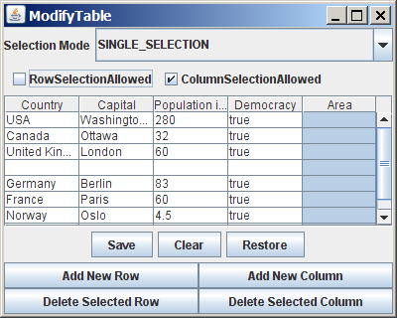
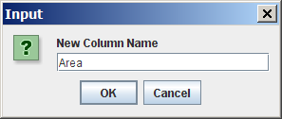
Example:
Modifying Rows and Columns
Problem: This example demonstrates the use of table models, table column models, list-selection models, and the TableColumn class. The program allows the user to choose selection mode and selection type, to add or remove rows and columns, and to save, clear, and restore table.
ModifyTable
Run

Slide 13
Table Renderers and Editors
Table cells are painted by cell renderers. By default, a cell object's string representation (toString()) is displayed and the string can be edited as it was in a text field. JTable maintains a set of predefined renderers and editors, listed in Table 36.1, which can be specified to replace default string renderers and editors.
The predefined renderers and editors are automatically located and loaded to match the class returned from the getColumnClass() method in the table model. To use a predefined renderer or editor for a class other than String, you need to create your own table model by extending a subclass of TableModel. In your table model class, you need to override the getColumnClass() method to return the class of the column, as follows:
  public Class getColumnClass(int column) {
  return getValueAt(0, column).getClass();
  }
By default, all cells are editable. To prohibit a cell from being edited, override the isCellEditable(int rowIndex, int columnIndx) method in TableModel to return false. By default, this method returns true in AbstractTableModel.

Slide 14
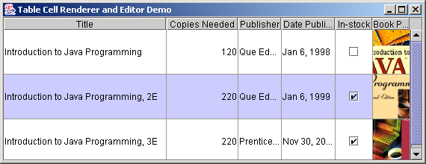
Example: Using Predefined Table Renderers and Editors
Problem: Write a program that displays a table for the books. The table consists of three rows with column names Title, Copies Needed, Publisher, Date Published, In-Stock, and Book Photo, as shown in Figure 36.32. Display all the columns using the predefined renderers and editors. Assume dates and icons are not editable; prohibit users from editing of these two columns.
MyTableModel
TableCellRendererEditorDemo
Run

Slide 15
Custom Table Renderers and Editors
Predefined renderers and editors are convenient and easy to use, but their functions are limited. The predefined image icon renderer displays the image icon in a label. The image icon cannot be scaled. If you want the whole image to fit in a cell, you need to create a custom renderer.
A custom renderer can be created by extending the DefaultTableCellRenderer, which is a default implementation for the TableCellRender interface. The custom renderer must override the getTableCellRendererComponent() to return a component for rendering the table cell. The getTableCellRendererComponent() is defined as follows:
public Component getTableCellRendererComponent
(JTable table, Object value, boolean isSelected,
boolean isFocused, int row, int column)
This method signature is very similar to the getListCellRendererComponent() method used to create custom list cell renderers.

Slide 16
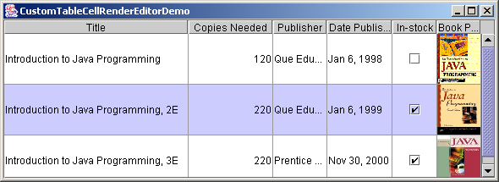
Example: Using Custom Table Renderers and Editors
Problem: Revise Example 36.9, “Using Predefined Table Renderers and Editors,” to display scaled image icons and to use a custom combo editor to edit the cells in the Publisher column.
CustomTableCellRenderEditorDemo
Run

Slide 17
Table Events
JTable does not fire table events. It fires the events such as MouseEvent, KeyEvent, and ComponentEvent inherited from its superclass JComponent. Table events are fired by table models, table column models, and table-selection models whenever changes are made to these models. Table models fire TableModelEvent when table data are changed. Table column models fire TableColumnModelEvent when columns are added, removed, or moved, or when the column selection changes. Table-selection models fire ListSelectionEvent when the selection changes.

Slide 18
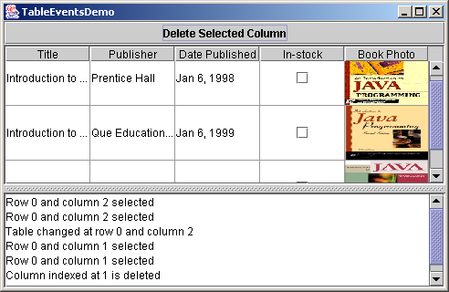
Example: Using Table Events
Problem: This example demonstrates handling table events. The program displays messages on a text area when a row or a column is selected, when a cell is edited, or when a column is removed.
TableEventDemo
Run

Slide 19
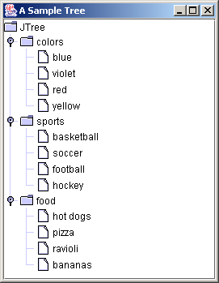
JTree
JTree is a Swing component that displays data in a treelike hierarchy.
Root
Leaf

Slide 20
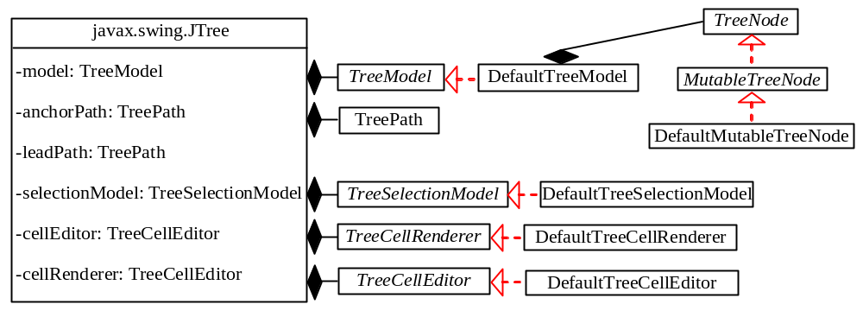
Tree Models
While JTree displays the tree, the data representation of the tree is handled by TreeModel, TreeNode, and TreePath. TreeModel represents the entire tree, TreeNode represents a node, and TreePath represents a path to a node. Unlike the ListModel or TableModel, the tree model does not directly store or manage tree data. Tree data are stored and managed in TreeNode and TreePath.
The TreeSelectionModel interface handles tree node selection.
The DefaultTreeCellRenderer class provides a default tree node renderer that can display a label and/or an icon in a node.
The DefaultTreeCellEditor can be used to edit the cells in a text field.

Slide 21
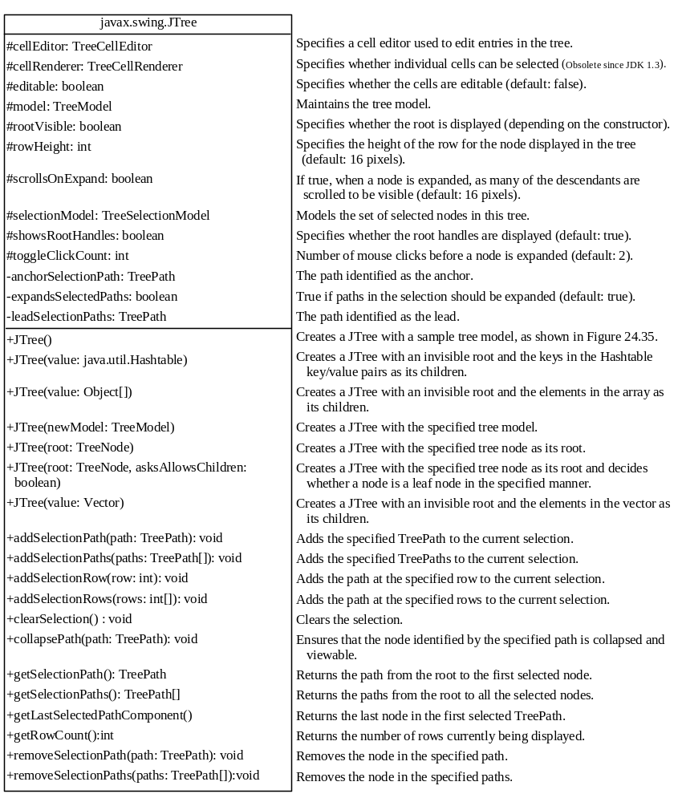
The JTree Class

Slide 22
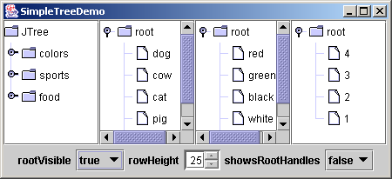
Example: Simple Tree Demo
Problem: Write a program to create four trees: a default tree using the no-arg constructor, a tree created from an array of objects, a tree created from a vector, and a tree created from a hash table. Enable the user to dynamically set the properties for rootVisible, rowHeight, and showsRootHandles.
SimpleTreeDemo
Run

Slide 23
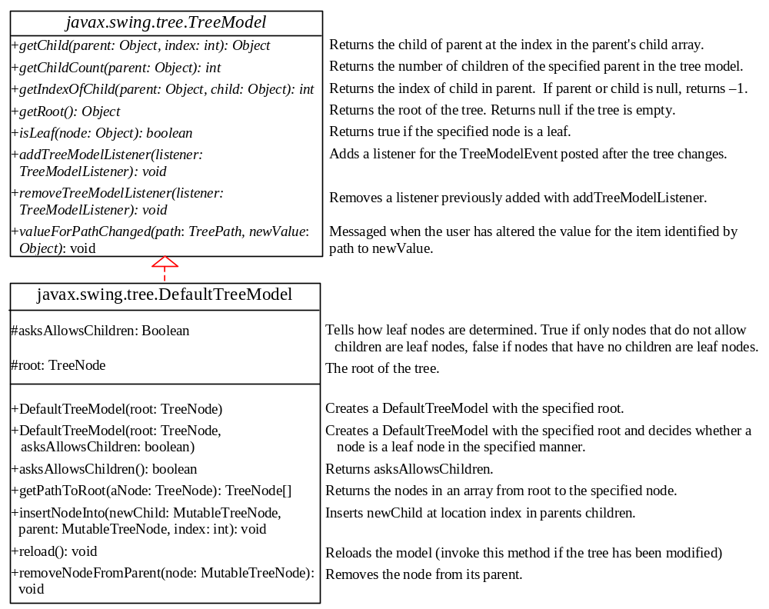
TreeModel and DefaultTreeModel
TreeModel contains the structural information about the tree, and tree data are stored and managed by TreeNode.
DefaultTreeModel is a concrete implementation for TreeModel that uses TreeNodes.

Slide 24
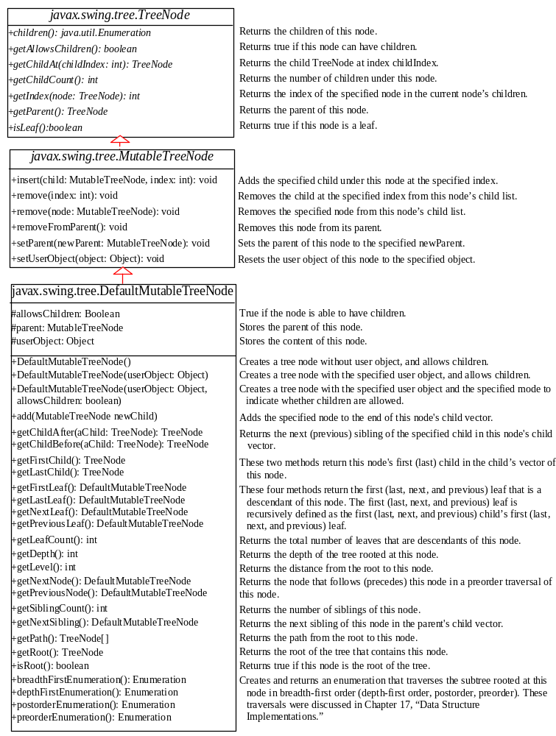
TreeNode, MutableTreeNode, and DefaultMutableTreeNode
TreeNode stores models a single node in the tree.
MutableTreeNode defines a subinterface of TreeNode with additional methods for changing the content of the node, for inserting and removing a child node, for setting a new parent, and for removing the node itself.
DefaultMutableTreeNode is a concrete implementation of MutableTreeNode.

Slide 25
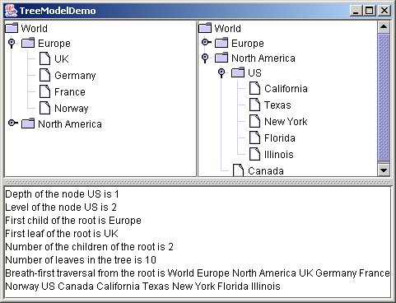
Example: Tree Model Demo
Problem: Write a program to create two trees that displays world, continents, countries and states. The two trees display identical contents. The program also displays the properties of the tree in a text area.
TreeModelDemo
Run

Slide 26
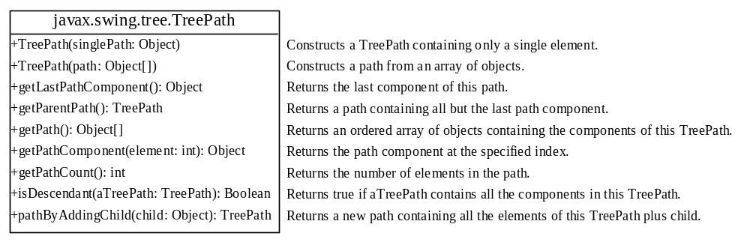
The TreePath Class
The TreePath class represents a path from an ancestor to a descendant in a tree.

Slide 27
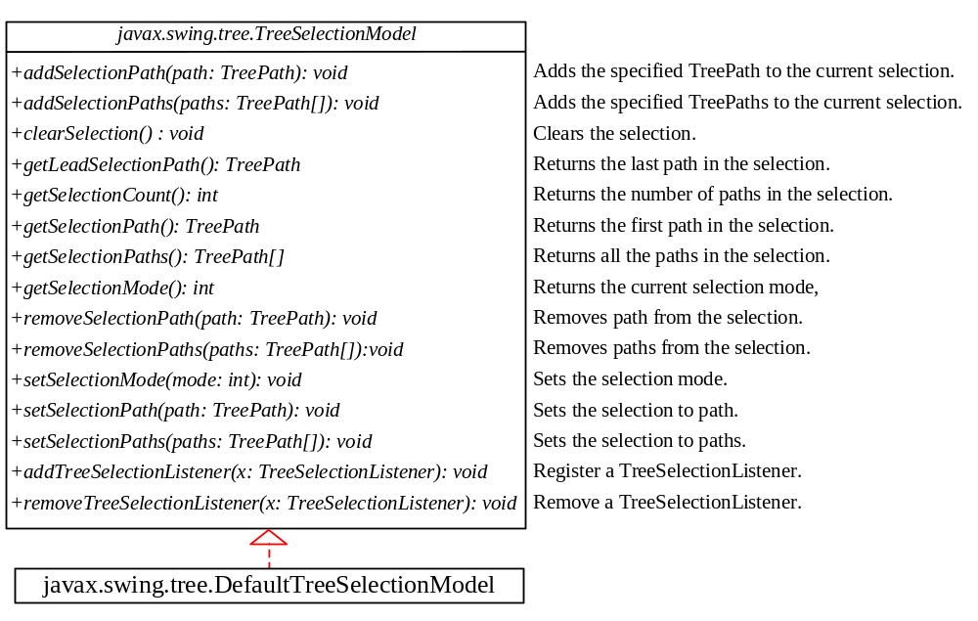
TreeSelectionModel and DefaultTreeSelectionModel
The selection of tree nodes is defined in the TreeSelectionModel interface.
The DefaultTreeSelectionModel class is a concrete implementation of the TreeSelectionModel, which maintains an array of TreePath objects representing the current selection.

Slide 28
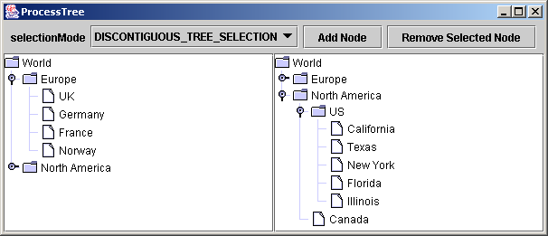
Example: Modifying Trees
Problem: Write a program to create two trees that displays the same contents: world, continents, countries and states, as shown in Figure 36.44. For the left tree on the left, enable the user to choose a selection mode, add a new child under the first selected node, and remove all the selected nodes.
ProcessTree
Run

Slide 29
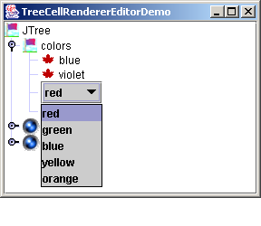
Tree Node Rendering
DefaultTreeCellRenderer renderer =
(DefaultTreeCellRenderer)jTree1.getCellRenderer();
renderer.setLeafIcon(yourCustomLeafImageIcon);
renderer.setOpenIcon(yourCustomOpenImageIcon);
renderer.setClosedIcon(yourCustomClosedImageIcon);
renderer.setBackgroundSelectionColor(Color.red);

Slide 30
Tree Editing
// Customize editor
JComboBox jcboColor = new JComboBox();
jcboColor.addItem("red");
jcboColor.addItem("green");
jcboColor.addItem("blue");
jcboColor.addItem("yellow");
jcboColor.addItem("orange");
jTree1.setCellEditor(new DefaultCellEditor(jcboColor));
jTree1.setEditable(true);

Slide 31
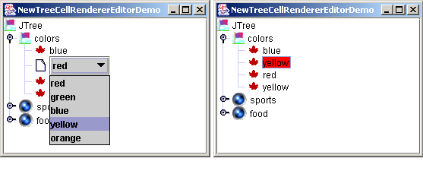
Tree Rendering and Editing
jTree1.setCellEditor
(new DefaultTreeCellEditor(jTree1,
new DefaultTreeCellRenderer(),
new DefaultCellEditor(jcboColor)));

Slide 32
Tree Events
JTree can fire TreeSelectionEvent and TreeExpansionEvent, among many other events. Whenever a new node is selected, JTree fires a TreeSelectionEvent. Whenever a node is expanded or collapsed, JTree fires a TreeExpansionEvent. To handle the tree selection event, a listener must implement the TreeSelectionListener interface, which contains a single handler named valueChanged method. TreeExpansionListener contains two handlers named treeCollapsed and treeExpanded for handling node expansion or node closing.

